Slide 1
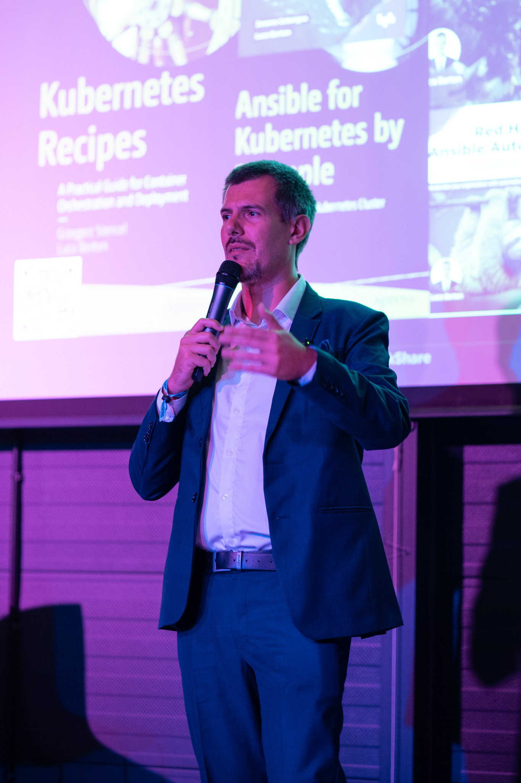
Luca Berton
Cloud Native Engineering Leader & Author
Specializing in AWS/Azure/GCP, Kubernetes, Ansible, Terraform, and end-to-end MLOps. Building secure, scalable platforms that ship and save.

Slide 2
Engineering Excellence at Scale
Luca Berton is a cloud native engineering leader with deep expertise across multi-cloud environments, container orchestration, and full-stack MLOps. I designs high-availability, secure platforms and has led automation at million-resource scale, driving $3M+ yearly savings and +25% operational efficiency.
1M+
Resources Automated
My work spans resilient hybrid cloud solutions compliant with SOC 2 and ISO 27001, AI-driven ESG products serving 100+ SMEs, and GPU workload optimization for enterprise ML pipelines.
$3M+
Annual Savings
25%
Efficiency Gain

Slide 3





Core Expertise
Multi-Cloud Platforms
AWS, Azure, GCP architecture and deployment at enterprise scale
Kubernetes & Orchestration
High-availability clusters, GPU scheduling, multi-tenant security
Infrastructure as Code
Ansible, Terraform, CI/CD pipelines automating millions of resources
End-to-End MLOps
Model orchestration, feature stores, observability, cost optimization

Slide 4
Professional Journey
Dell Technologies — Senior Consultant
1
2024–Present
Leading cloud native transformations for major European financial institutions including BPCE, Société Générale, and ABN AMRO. Architected AI-driven ESG calculators serving 100+ SMEs.
2
JPMorgan Chase — VP Infrastructure
2022–2024
Designed and deployed million-resource infrastructure with Ansible, Kubernetes and Terraform, achieving +25% efficiency and $3M annual savings.
Red Hat — Ansible Software QE
3
2019–2022
Automated test frameworks for 2,000+ cloud use cases across AWS and Azure. Contributed to Log4Shell Ansible remediation adopted by millions.

Slide 5
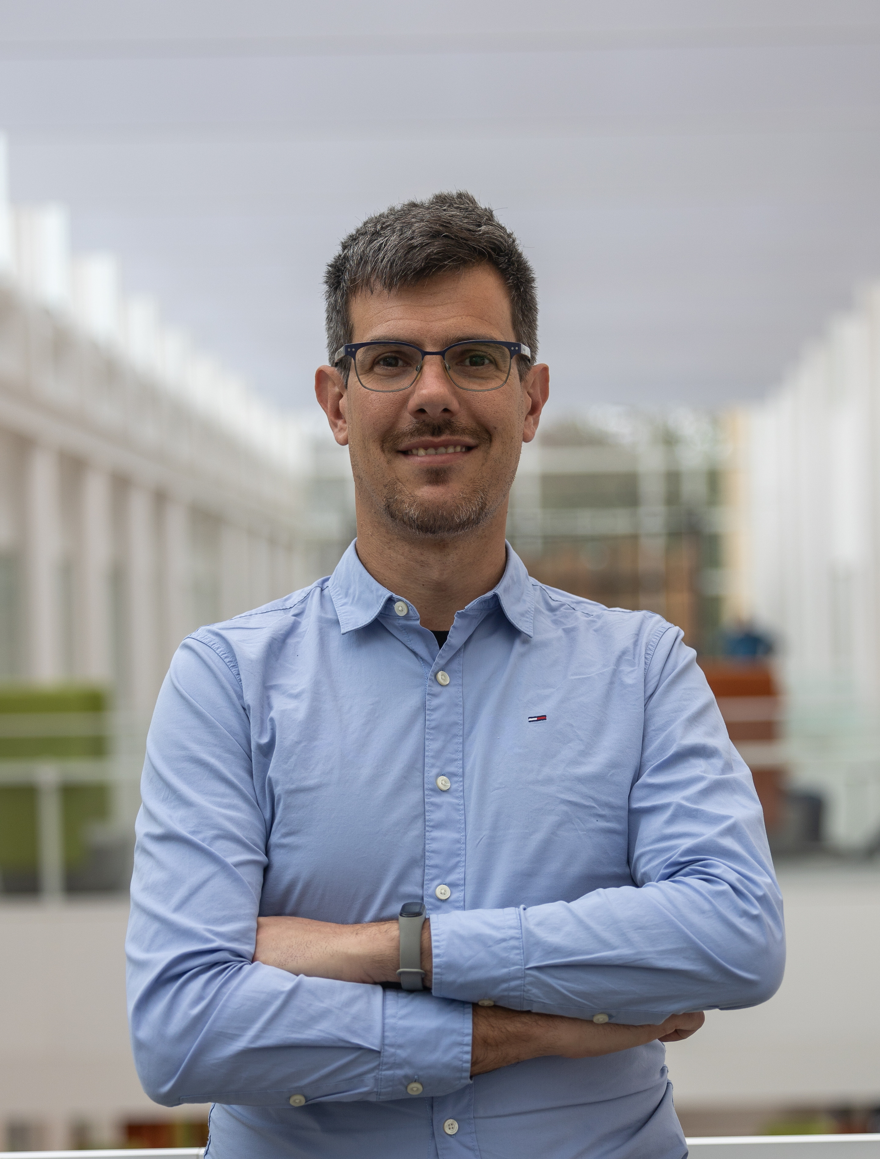
Select Client Impact
1
Safran
POC with Red Hat OpenShift AI + GPU Device Plugin, NVIDIA MIG, ClearML, and Run:ai. Secured multi-tenant GPU training with ~40% infrastructure overhead reduction.
2
Société Générale
Automated disaster recovery for 25,000+ VMware VMs using Dell PowerMax + Ansible with custom Python dynamic inventory, enabling near-seamless failover and failback.
3
ABN AMRO
Integrated Ansible Automation Platform with Azure Pipelines, managing 85,000+ resources via Ansible, Bicep, and ARM templates.
4
LevelUP ESG
Architected AI-driven ESG calculators serving 100+ SMEs, enabling accessible sustainability measurement for organizations without enterprise budgets.

Slide 6
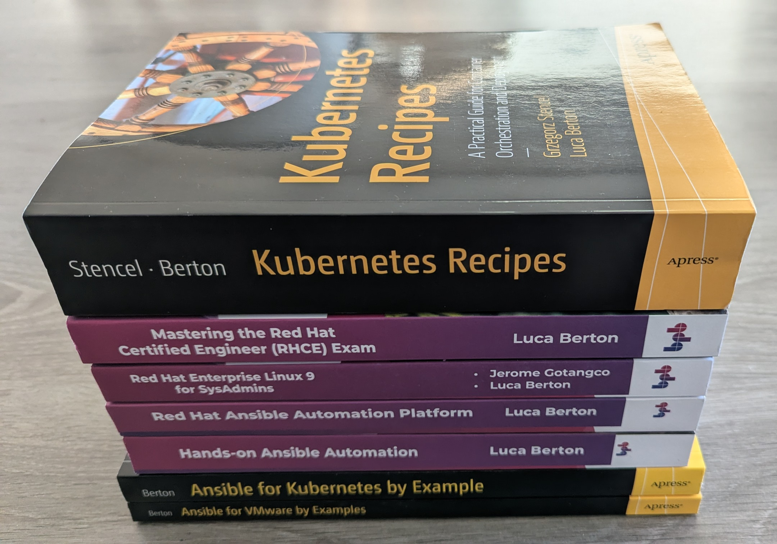
Published Author
Seven Technical Books
Practical RHEL AI — Apress/Springer, Dec 2025
Kubernetes Recipes — Apress/Springer, Apr 2025
Red Hat Enterprise Linux 9 for SysAdmins — BPB, Feb 2025
Mastering the RHCE Exam — BPB, Dec 2024
Red Hat Ansible Automation Platform — BPB, Dec 2023
Ansible for Kubernetes by Example — Apress, May 2023
Ansible for VMware by Examples — Apress, Dec 2022

Slide 7






Speaking & Advisory Topics
Platform Engineering at Scale
Pragmatic MLOps
Lessons from automating ~1M resources with Kubernetes, Terraform, CI/CD, and policy compliance baked in from day one.
From prototype to production—feature stores, model orchestration, observability, and cost control strategies that work.
Secure AI & Cloud
GPU Workloads on K8s
Designing SOC2/ISO27001 aligned platforms with runtime security and eBPF-powered visibility using Tetragon.
Multi-tenant GPU orchestration with MIG and DRA, intelligent scheduling, and cost-performance trade-offs.
ESG Technology
Hands-On Workshops
Building AI-powered ESG calculators for SMBs—data architecture, calculation methods, and measurable impact.
Interactive labs covering Kubernetes, Ansible, Terraform, CI/CD pipelines, and cloud automation best practices.

Slide 8

Multi-Platform Instructor
Coursera
Pluralsight
Educative
Operationalizing ML Models
Optimizing Azure DevTest Labs
Automating IT Infrastructure with Ansible
Intro to Chip Design with Open Source EDA
Federated Learning & Privacy-preserving RAGs
YouTube
~50K views/month on Ansible & Terraform Pilot channel with 300+ hands-on demos and use cases
API Validation with Postman
Back-End Infrastructure
K8s Labs: Storage & Scheduling
The IT Ops Sessions

Slide 9

Certifications & Credentials
RHCSA
LFCE
Red Hat Certified System Administrator
Linux Foundation Certified Engineer
AWS
Tetragon
EKS & Database Certifications
Cisco/Isovalent Security Visibility Architect
Languages: Italian (native), English (professional), French (limited), Czech & Dutch (elementary)

Slide 10

Let's Connect
Luca Berton
Location: Amsterdam, Netherlands
Phone: +31 6 1225 5399
Email: luca@lucaberton.com
Web: lucaberton.com
LinkedIn: linkedin.com/in/lucaberton
Ansible Pilot: ansiblepilot.com
Available for speaking engagements, workshops, and advisory services. Please include audience size, event date, format, topics, and desired outcomes.

